Slide 1
Classification of Diseases and Conditions Affecting the Periodontium

Slide 2
In 1999, a classification system for diseases and conditions that affect the periodontium two decades.
The 1999 classification of periodontal diseases was based on their:
extent (generalized versus localized);
severity (slight, moderate, or severe);
rate of progression (aggressive versus chronic);
localization (i.e., contained within the gingiva, as in gingivitis, or further involving alveolar bone, as in periodontitis)

Slide 3
In 2017, the American Academy of Periodontology (AAP) and the European Federation of Periodontology (EFP) updated definitions for periodontal health, gingival disease, periodontitis, periodontal manifestations of systemic diseases, and periimplant diseases.
These redefined classifications, especially for periodontitis, are intended to provide a more precise diagnosis characterized by a multidimensional staging and grading system

Slide 4
Periodontal Health
Periodontal health is defined as a state free from inflammatory periodontal disease such as gingivitis, periodontitis, and other periodontal conditions.
periodontal health can be applied to patients who had a history of successfully treated periodontal diseases and are able to maintain periodontal tissues without clinical inflammation.

Slide 5
two categories of periodontal health diagnosis:
(1) clinical health on an intact periodontium;
(2) clinical gingival health on a reduced periodontium in a stable periodontitis patient or non-periodontitis patient (toothbrush trauma induced generalized gingival recession)

Slide 6
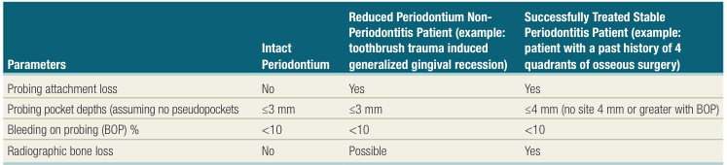
Periodontal Health

Slide 7
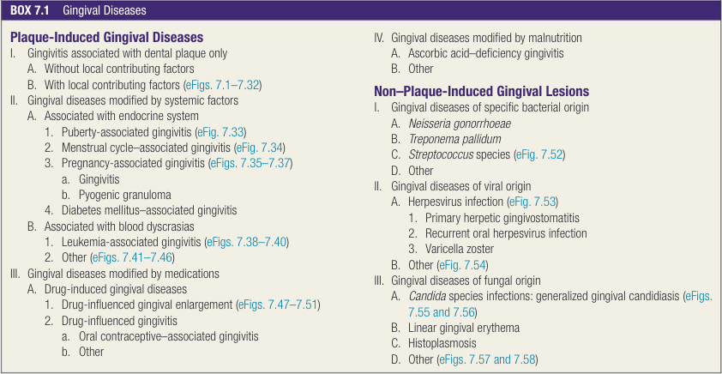
Gingival Diseases

Slide 8
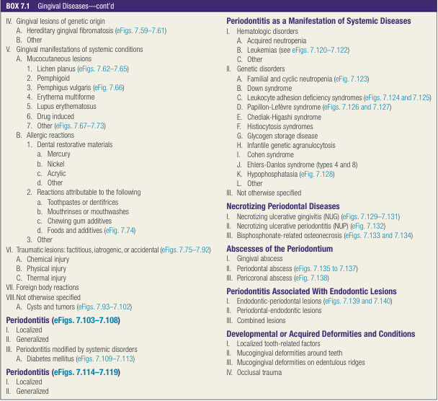

Slide 9
Gingival Diseases
Dental Biofilm Induced Gingivitis
Gingivitis that is associated with retained dental biofilm (plaque) is the most common form of gingival disease.
swelling, bleeding, and/or redness in the gingiva
Gingivitis is generally not associated with progressive attachment loss

Slide 10
Gingivitis can be categorized as localized or generalized based on the percentage of BOP sites
Localized gingivitis is defined as 10% to 30% BOP sites
generalized gingivitis is defined as greater than 30% BOP sites

Slide 11
Gingivitis may occur on an intact periodontium or on a reduced periodontium.
For all gingivitis patients, the probing depth of all sites should be ≤3 mm.
Gingivitis inflamed gingival tissues
tooth without previous attachment loss or
with a tooth that has previously undergone attachment and bone loss but exhibits probing depths ≤3 mm and is not currently losing attachment, even though gingival inflammation is present.
the appropriate definition would be “gingivitis on a reduced periodontium.

Slide 12
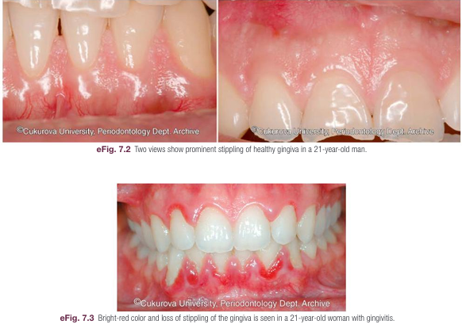

Slide 13
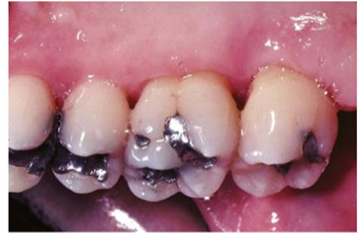
gingivitis on a reduced periodontium

Slide 14
Dental Biofilm Induced Gingivitis Associated With Biofilm Alone
Biofilm induced gingival disease is the result of an interaction between the microorganisms found in the dental biofilm and the inflammatory host response.
Microbial biofilm is thus considered the primary etiologic factor for gingivitis.
The extent, severity, and duration of the inflammatory response interaction can be altered by the local or systemic factors.
Gingivitis is fully reversible removal of local factors and reduction of the microbial load around the teeth.

Slide 15
Gingival Diseases Mediated by Local Factors
Local risk factors (i.e., predisposing factors), including dental plaque biofilm retention factors and oral dryness, can increase plaque accumulation by inhibiting plaque removal
Poorly contoured subgingival restorations are associated with increased gingival inflammation and progressive attachment loss.
Oral dryness caused by medications, Sjögren’s syndrome, radiation therapy for cancer, and other medical conditions result in increased plaque accumulation.
oral dryness can have an increased percentage of BOP

Slide 16
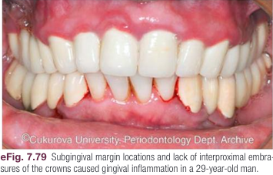

Slide 17
Gingival Diseases Mediated by Systemic Factors
Several systemic risk factors may contribute to gingivitis by exacerbating the gingival inflammatory response to dental biofilm.
altered response appears to result from the effects of systemic conditions on the host’s cellular and immunologic functions, but microbial biofilm is still the primary etiologic factor.

Slide 18
These systemic factors include:
smoking
hyperglycemia
nutritional factors
pharmacological agents
sex steroid hormones (puberty, menstrual cycle, pregnancy, oral contraceptives)
hematological conditions

Slide 19
Smoking is a major risk factor for both gingivitis and periodontitis.
The chemical components of cigarette can affect systemic immune response and induce microvascular vasoconstriction as well as fibrosis in gingiva.
The vasoconstriction may reduce BOP which influences clinical diagnosis of gingivitis.

Slide 20
Gingival diseases modified by malnutrition have received attention because of clinical descriptions of bright red, swollen, and bleeding gingiva associated with severe ascorbic acid (vitamin C) deficiency or scurvy.
Elevations in sex steroid hormones may mediate inflammatory response in gingiva.
One example is apparent during pregnancy when the incidence and severity of gingival inflammation may increase even in the presence of low levels of dental biofilm.

Slide 21
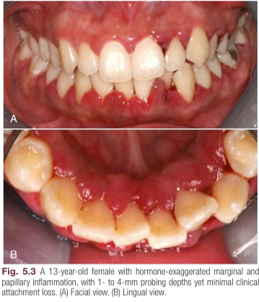
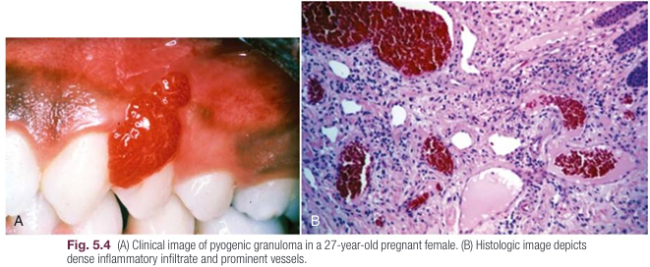

Slide 22
In blood dyscrasias (e.g., leukemia), the reduced number of immunocompetent lymphocytes in the periodontal tissues is associated with increased edema, erythema, and bleeding of the gingiva.
Gingival enlargement caused by the excessive infiltration of malignant blood cells is often associated with the swollen and spongy gingival tissues.

Slide 23
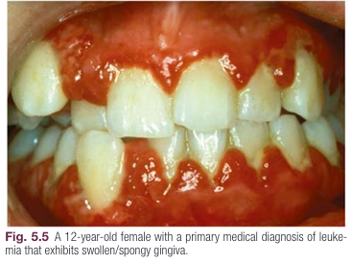

Slide 24
Drug Influenced Gingival Enlargement
Gingival diseases that are modified by medications include gingival overgrowth due to
anticonvulsant drugs such as phenytoin
immunosuppressive drugs such as cyclosporine
calcium channel blockers such as nifedipine, verapamil, diltiazem, and sodium valproate
The development and severity of gingival enlargement in response to medications is patient specific and is influenced by uncontrolled plaque accumulation

Slide 25
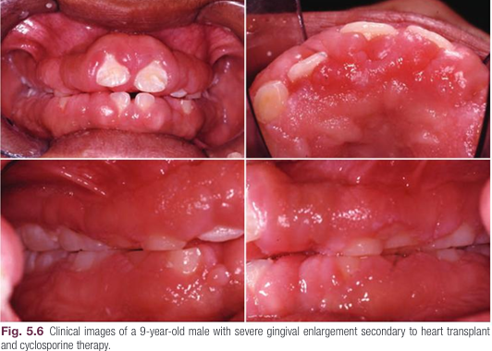

Slide 26
Non Dental Biofilm Induced Gingival Diseases
Oral manifestations of systemic conditions that produce lesions in the tissues of the periodontium are less common than biofilm induced gingivitis.

Slide 27
Genetic/develop mental disorders (hereditary gingival fibromatosis)
Specific infections (bacterial, viral, or fungal origin)
Inflammatory and immune conditions (hypersensitivity reactions, autoimmune diseases of skin and mucous membranes, granulomatous inflammatory lesions)
Reactive processes (epulides)
Neoplasms
Endocrine disorders, nutritional (vitamin C deficiency) and metabolic diseases
Traumatic lesions
Gingival pigmentations

Slide 28
These gingival conditions will not be fully resolved by removal of dental biofilm alone
uncontrolled plaque accumulation can worsen these conditions

Slide 29
Genetic/Developmental Disorders
autosomal-dominant or (rarely) autosomal-recessive modes of inheritance.
The gingival enlargement may completely cover the teeth, delay eruption
present as an isolated finding; alternatively, it may be associated with several more generalized syndromes

Slide 30
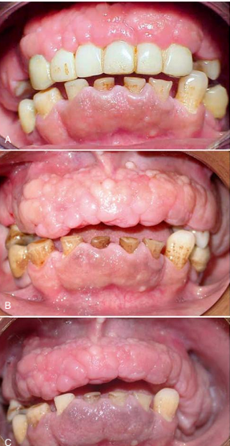

Slide 31
Specific Infections
Infections from three types of microorganisms, bacteria, fungi, or viruses can cause gingival diseases.
Neisseria gonorrhoeae and Treponema pallidum, transferred as a result of sexually transmitted diseases such as gonorrhea and syphilis
Streptococcal gingivitis is a rare entity that may present as an acute condition with fever, malaise, and pain associated with acutely inflamed, diffuse, red, and swollen gingiva with increased bleeding and occasional gingival abscess formation.
The gingival infections are usually preceded by tonsillitis

Slide 32
Gingival diseases of viral origin may be caused by a variety of deoxyribonucleic acid (DNA) and ribonucleic acid (RNA) viruses, with the most common being the herpesviruses.
Herpetic lesions are not uncommon and develop as intraoral blisters, usually grouped together, that quickly burst, leaving minuscule ulcerations.
Lesions are frequently related to the reactivation of latent viruses, especially as a result of reduced immune function.

Slide 33
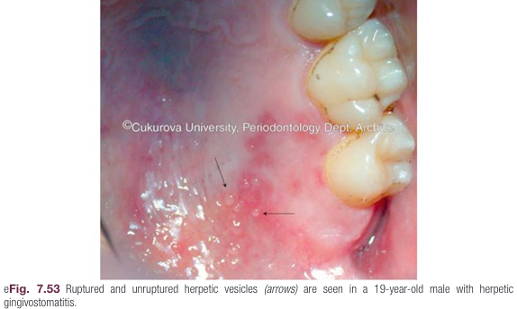
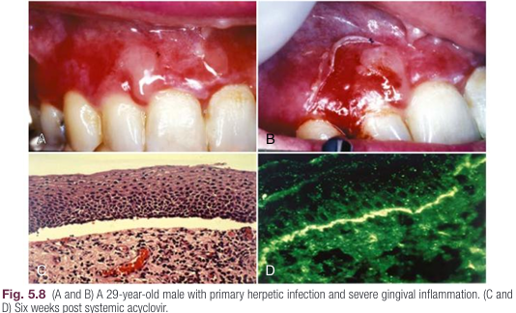

Slide 34
Gingival diseases of fungal origin are relatively uncommon in immunocompetent individuals, but they occur more frequently in immunocompromised individuals and in those with disturbed microbiota from the long term use of broad-spectrum antibiotics.
The most common oral fungal infection is candidiasis (Candida albicans).
Candidiasis can also be seen under prosthetic devices, in individuals using topical steroids, and in individuals with decreased salivary flow, increased salivary glucose, or decreased salivary pH.

Slide 35
A generalized candidal infection may manifest as white patches on the gingiva, tongue, or oral mucous membrane that can potentially be removed with gauze and leave a red, bleeding surface.
In HIV seropositive persons, candidal infection may present as continuous erythematous stripe of the attached gingiva; this has been referred to as linear gingival erythema or HIV associated gingivitis.

Slide 36
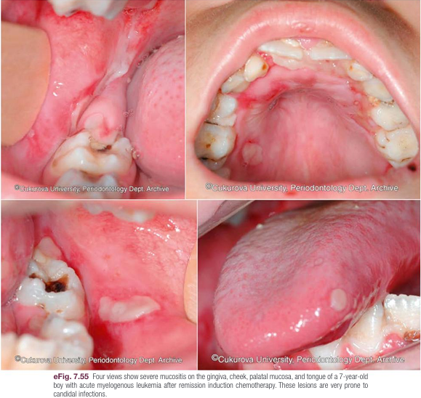

Slide 37
Inflammatory and Immune Conditions
Gingival manifestations of altered inflammatory and immune conditions may appear as desquamative lesions, ulcerations of the gingiva, or both.
Mucous membrane pemphigoid is a systemic autoimmune disease that affects mucous membranes and some times the skin. Oral and ocular mucosal tissues are most frequently affected.
It is characterized by sloughing gingival tissues that leave painful ulcerations of the gingiva.
Autoantibodies are targeted at the basement membrane, and histologically the destruction resembles a subepithelial blister.
Case Scenario 5.2 depicts gingival recession accompanied by a mucosal lesion located on the gingiva manifesting with a white lacy pattern with characteristic striations.

Slide 38
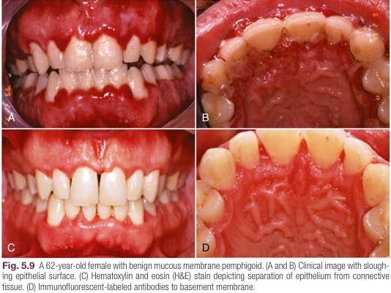
Mucous membrane pemphigoid

Slide 39
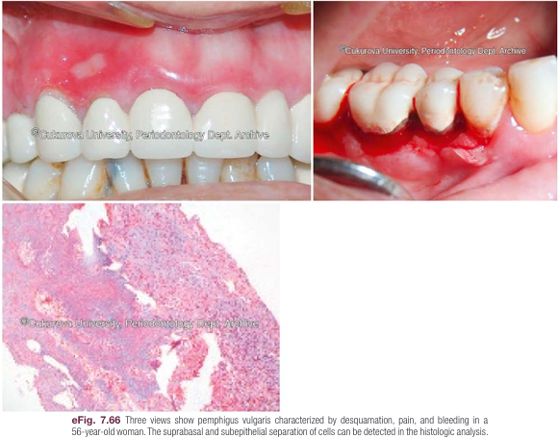
pemphigus vulgaris

Slide 40
Allergic reactions that manifest with gingival changes are uncommon but have been observed in association with several restorative materials ,dentifrices, mouthwashes, chewing gums, and foods.
The diagnosis of these conditions may prove difficult and may require an extensive history and the selective elimination of potential causes.
Histologic traits of biopsies from gingival allergic reactions include a dense infiltrate of eosinophilic cells.

Slide 41
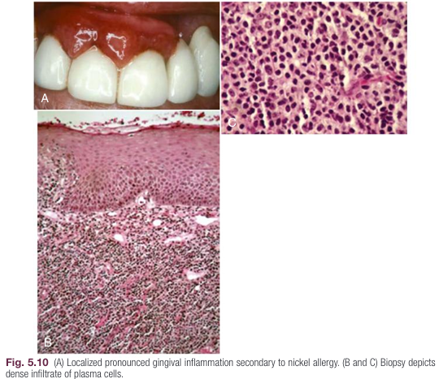
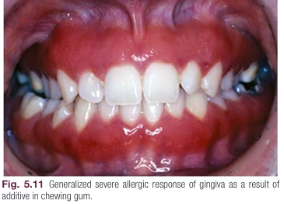

Slide 42
Traumatic Lesions
Traumatic lesions may be self-inflicted and factitious in origin, which means that they are intentionally or unintentionally produced by artificial means.
Other examples of traumatic lesions include toothbrush trauma that results in gingival ulceration, recession, or both.
Individuals who perform aggressive horizontal brushing are often found to have gingival recession or cervical abrasion on the teeth quadrants contra lateral to their dominant hand.

Slide 43
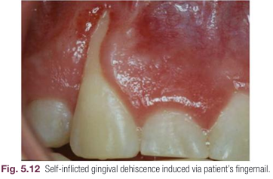

Slide 44
Iatrogenic trauma (i.e., induced by the dentist or health professional) to the gingiva may also lead to a gingival lesion.
Such trauma may be caused directly (i.e., via use of dental instruments) or by the induction of cement or preventive or restorative materials.
Peripheral ossifying fibroma may develop in response to the embedment of a foreign body.
Self inflicted accidental damage to the gingiva may also occur as a result of minor burns from hot foods and drinks

Slide 45
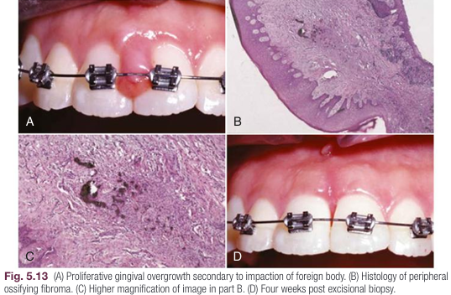

Slide 46
Periodontitis
Periodontitis is defined as “an inflammatory disease of the supporting tissues of the teeth caused by specific microorganisms or groups of specific microorganisms, resulting in progressive destruction of the periodontal ligament and alveolar bone, with increased probing depth formation, recession, or both.
The clinical feature that distinguishes periodontitis from gingivitis is the presence of a clinically detectable attachment loss as a result of inflammatory destruction of the periodontal ligament and alveolar bone.

Slide 47
This loss is often accompanied by periodontal pocket formation and changes in the density and height of the subjacent alveolar bone.
In some cases, recession of the marginal gingiva may accompany attachment loss,
probing depth or clinical attachment levels?

Slide 48
For a definitive diagnosis of periodontitis, it is required that the patient present with detectable interdental clinical attachment loss in at least two non-adjacent teeth, or buccal or lingual clinical attachment loss (≥3 mm) jointly with probing depths (>3 mm) on two or more teeth.

Slide 49
It is important to ensure that tissue destruction (clinical attachment loss) took place due to periodontal diseases and not due to other conditions such as:
(a) trauma-induced gingival recession,
(b) dental caries extending subgingivally,
(c) clinical attachment loss on the distal aspect of the second molar (associated with mal position or extraction of the third molar),
(d) endodontic pathology draining through periodontium,
(e) vertical root fracture

Slide 50
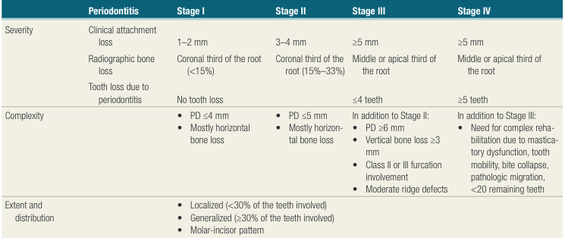
Stage: localized & generalized
present with the distinct molar- incisor pattern of disease involvement

Slide 51
In the AAP/EFP 2018 classification of periodontal diseases, a multidimensional staging and grading system was introduced to subclassify periodontitis disease entities.
The severity of periodontal disease at the time of presentation and the complexity of disease management dictate the staging,
grading offers additional information, including the rate of past progression of the disease and the risk for future progression.

Slide 52
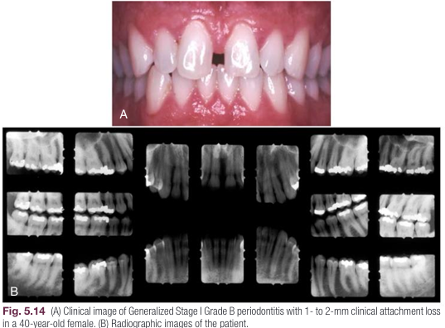

Slide 53
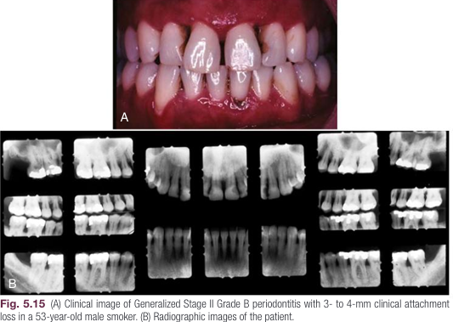

Slide 54
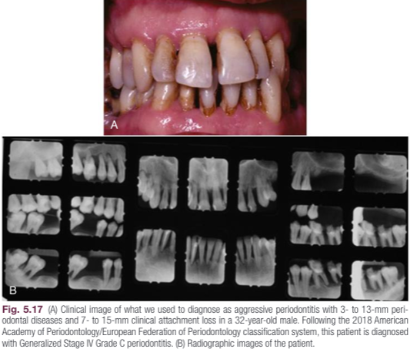

Slide 55
Grading
Grading provides the likelihood of post treatment disease progression, and it can change along the way because it depends on the state of the patient at the time of examination.
In essence, grading is this dimension of the new classification enables clinicians to incorporate individual characteristics into the diagnosis and related treatment plans.

Slide 56
the percentage of bone loss with respect to the patient’s age
smoking and diabetes

Slide 57
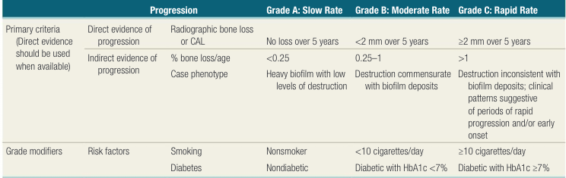

Slide 58
Periodontal Manifestations of Systemic Diseases
Several hematologic and genetic disorders have been associated with the development of periodontitis in affected individuals.
periodontitis occurs as a manifestation of these systemic diseases when the underlying disease is the major predisposing factor and the local factors (e.g., large quantities of plaque and calculus) are not clearly evident or their presence alone does not justify the severity or progression of disease.

Slide 59
Papillon Lefèvre syndrome (PLS)
severe periodontitis as one of its manifestations
PLS is an autosomal recessive disorder caused by mutations in the cathepsin C gene located on chromosome 11q14
The clinical manifestations of the syndrome include severe periodontitis with rapid destruction and diffuse keratoderma on the palms, soles, knees, or all three.

Slide 60
Impaired neutrophil function is considered to be the primary cause of PLS and eventually results in the deregulation of the polymorphonuclear leukocyte response to microbial infection.
Aggregatibacter acti nomycetemcomitans (Aa), Porphyromonas gingivalis, Tannerella forsythia, Fusobacterium nucleatum, and Prevotella intermedia
Serum immunoglobulin G titers against Aa are typically elevated in individuals with PLS, thereby implicating Aa as a significant causative factor

Slide 61
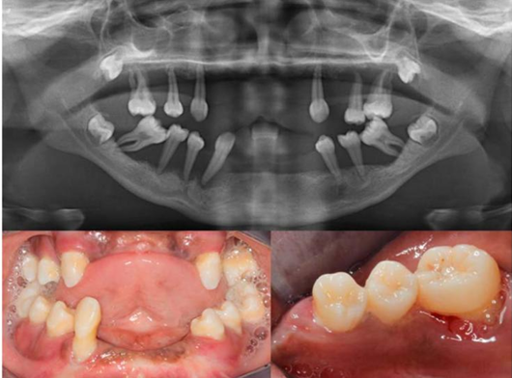
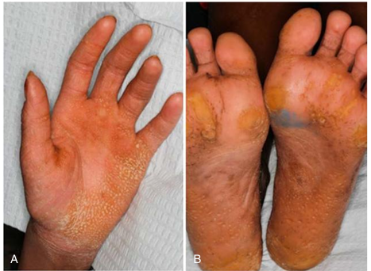

Slide 62
hyperkeratosis, the loss of primary and permanent teeth, autosomal recessive pattern of inheritance as being essential criteria to verify a diagnosis of PLS
Secondary manifestations of PLS may include ectopic intracranial calcifications and increased susceptibility to infections, including pyogenic liver abscesses that can be fatal

Slide 63
PLS clinically affects both the primary and permanent dentition.
Signs of palmoplantar keratoderma usually appear simultaneously with the eruption of the first primary teeth (i.e., 5 to 6 months of age), but they may appear as early as the age of 1 month.
By the ages of 4 to 5 years, the primary teeth have typically exfoliated or been extracted as a result of severe periodontal destruction.
Subsequently, an edentulous phase occurs during which a reduction in the oral microbial load is noted and gingival health is restored.
After the eruption of the permanent dentition, a similar cycle of severe periodontal inflammation is repeated that generally does not respond to conventional periodontal therapy.
An increase in tooth mobility and periodontal abscesses is frequently observed shortly after the eruption of the permanent teeth.

Slide 64
the successful treatment of periodontitis among individuals with PLS requires the eradication of Aa.
Treatment of the primary dentition includes frequent prophylaxis appointments to ensure that the patient maintains adequate masticatory function and nutrition during early childhood.
To create a healthy environment for the permanent teeth to erupt into, it has been advocated that a course of antibiotics effective against Aa be systemically administered along with the extraction of all primary teeth 6 to 12 months before the eruption of the first permanent tooth

Slide 65
The combination of trimethoprim and sulfamethoxazole (i.e., cotrimoxazole) has also been shown to be effective against Aa and to lead to a significant improvement in neutrophilic function against Aa.
A stringent periodontal maintenance schedule is of utmost importance to efficaciously monitor the patient’s oral hygiene and to be able to intercede promptly if signs of inflammation reoccur.
Retinoids, which are synthetic analogues of vitamin A, a treatment modality against PLS skin manifestations, have also been considered as immunomodulatory adjuncts for the treatment of PLS-associated periodontitis.

Slide 66
squamous cell carcinoma, and other disorders, such as Langerhans cell histiocytosis that can lead to periodontal bone loss, independent of local factors.

Slide 67
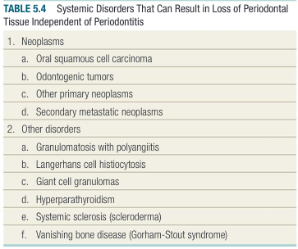

Slide 68
Necrotizing Periodontal Diseases
The clinical characteristics of necrotizing periodontal diseases (NPD) may include ulcerated and necrotic papillary and marginal gingiva that is covered by a yellowish white or grayish slough or pseudomembrane,
blunting and cratering of the papillae, bleeding on provocation or spontaneous bleeding, pain, and fetid breath.
Similar to periodontal abscess, NPD also belong to acute periodontal lesions
NPDs may be accompanied by fever, malaise, and lymphadenopathy, although these characteristics are not consistent.

Slide 69
NPDs are microbial, infectious conditions but a compromised host immune response can make the condition worse.
Three forms of NPD have been described:
necrotizing gingivitis (NG), necrotizing periodontitis (NP), and necrotizing stomatitis (NS)
the major difference between NG and NP is that there is no rapid bone loss in NG.

Slide 70
The defining characteristics of NG are its bacterial cause, necrotic lesion, and predisposing factors, such as psychological stress, smoking, and immunosuppression.
Malnutrition contributing factor
NG is usually seen as an acute lesion that responds well to antimicrobial therapy in combination with professional plaque and calculus removal as well as improved oral hygiene.
NP differs from NG in that in NP, the loss of clinical attachment and alveolar bone is a consistent feature originating from the proximal region

Slide 71
NS is a more severe form of NPDs with soft tissue necrosis extending beyond the gingiva and bone denudation occurring in the area of alveolar mucosa, with potential bony sequestrum formation or osteitis.
systemically compromised individuals

Slide 72
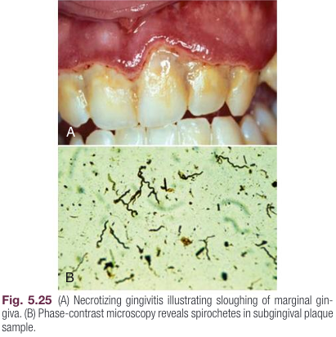
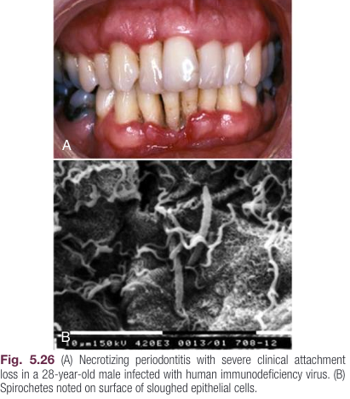

Slide 73
Other Periodontal Conditions: Periodontal Abscesses
A periodontal abscess is a localized acute and purulent infection within the gingival wall of the periodontal pocket.
The tissue destruction is rapid, and the infection is associated with risk of systemic dissemination.
Periodontal abscesses are common infections in the oral cavity that require immediate management. These abscesses should be classified according to the etiological factors, including pre-existing deep periodontal pockets, foreign body reactions, overgrowth of opportunistic bacteria, or inadequate orthodontic forces.
Identifying these etiologic factors can help clinical management.

Slide 74
Endodontic Periodontal Lesions
Endodontic-periodontal lesions (EPLs) are clinical conditions present in a tooth with a pathological communication between the pulpal and periodontal tissues and can manifest in acute or chronic forms.
The primary etiological factors include:
(1) endodontic and/or periodontal infections; (2) trauma and/or iatrogenic factors (e.g., root fracture or cracking, root/pulp chamber/furcation perforation, external root resorption or pulp necrosis).

Slide 75
may happen in sequence or simultaneously
EPLs might be:
triggered by pulp infection first that then affect the periodontium;
triggered by periodontal destruction first which then affect pulp tissues; or
triggered by both pulp and periodontal infections concomitantly.
It is somewhat uncommon for periodontal infection to lead to endodontic infection than vice versa.

Slide 76
EPLs according to the extent of periodontal destruction:
Grade 1: narrow deep periodontal pocket in one tooth surface;
Grade 2: wide deep periodontal pocket in one tooth surface;
Grade 3: deep periodontal pockets in greater than one tooth surface.
Generally, a tooth with EPL caused by root fracture, perforation, or severe periodontal destruction has the worst prognosis.

Slide 77
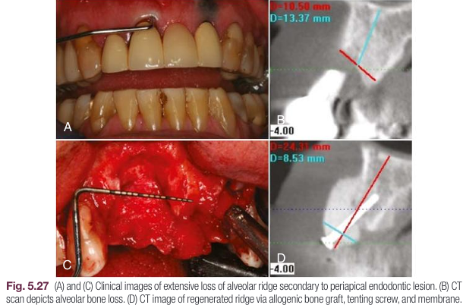

Slide 78
If endodontic infection is the primary factor, root canal therapy may be the only treatment necessary to restore the periodontal apparatus of the tooth with endodontic-periodontal lesions.

Slide 79
Mucogingival Deformities and Conditions
Mucogingival deformity is a generic term used to describe the mucogingival junction and its relationship to the gingiva, the alveolar mucosa, and frenula muscle attachments.
A mucogingival deformity is a significant departure from the normal shape of the gingiva and the alveolar mucosa, and it may involve the underlying alveolar bone.

Slide 80
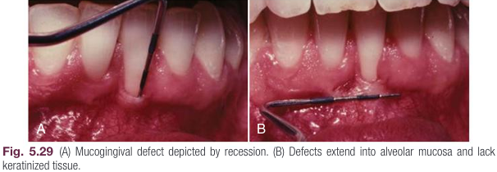

Slide 81
Occlusal Trauma and Traumatic Occlusal Forces
Traumatic occlusal force is defined as any occlusal force, which may exceed the adaptive capacity of the individual person or site, resulting in injury of the teeth and/or the periodontal attachment apparatus.
The signs and symptoms of traumatic occlusal forces include fremitus, tooth mobility, tooth migration, excessive occlusal wear, thermal sensitivity, discomfort/pain on chewing, fractured teeth, radiographically widened periodontal ligament space, root resorption, and hypercementosis. Occlusal trauma is a histologic term describing the injury to the periodontal attachment apparatus.

Slide 82
Traumatic occlusal forces can be classified into primary occlusal trauma (injury resulting in tissue changes at a tooth or teeth with normal periodontal support); secondary occlusal trauma (injury resulting in tissue changes at a tooth or teeth with reduced support); or orthodontic forces. So far, there is no strong clinical evidence that traumatic occlusal forces result in periodontal attachment loss, non-carious cervical lesions, or gingival recessions.

Slide 83
Prostheses and Tooth-Related Factors That Modify or Predispose to Plaque-Induced Gingival Diseases/Periodontitis
Several conditions, associated with prostheses and teeth, may pre dispose to plaque accumulation resulting in periodontal diseases.
Localized tooth related factors include tooth anatomic factors, root fractures, cervical root resorption, cemental tears, root proximity and altered passive eruption.
Anatomic factors (e.g., cervical enamel projections, palatal grooves, enamel pearls) have been associated with clinical attachment loss, especially in furcation areas.

Slide 84
Palatogingival grooves, which are found primarily on maxillary incisors, are observed in 1% to 8.5% of the population and are associated with increased plaque accumulation and clinical attachment, as well as bone loss.
Proximal root grooves on incisors and maxillary premolars also predispose individuals to plaque accumulation, inflammation, and the loss of clinical attachment and bone.
Misaligned teeth ,Open interproximal contacts that contribute to food impaction have been associated with an increased loss of attachment.

Slide 85
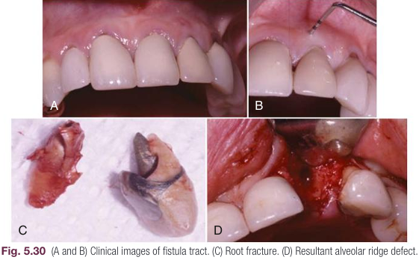
Root fractures may be associated with endodontic or restorative procedures, as well as traumatic forces and may lead to periodontal involvement through the apical migration of plaque along the fracture line.

Slide 86
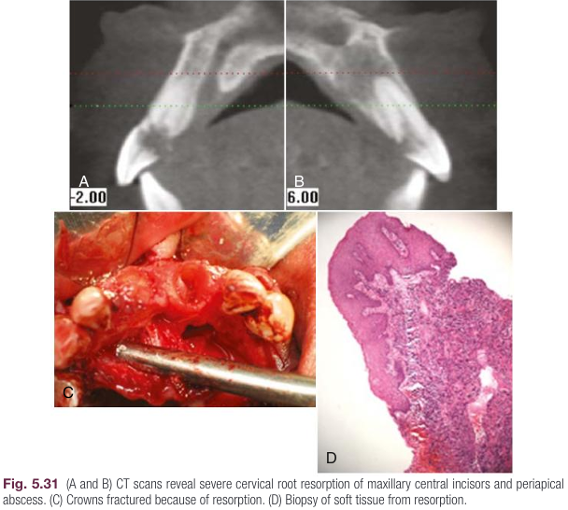
Invasive cervical root resorption (ICR) and cemental tears may lead to periodontal destruction when the lesion communicates with the oral cavity and allows bacteria to migrate subgingivally.

Slide 87
Localized dental prosthesis related factors include restoration margins placed within the supracrestal attached tissues (previous biologic width), clinical procedures related to the fabrication of indirect restorations, and hypersensitivity/toxicity reactions to dental materials.

Slide 88
Dental restorations or appliances are frequently associated with the development of gingival inflammation.
Restorations placed deep in the sulcus or within the junctional epithelium may impinge on the supracresal tissue attachment (previous biologic width) resulting in inflammation and the loss of clinical attachment and bone.
Contour of a complete crown restoration can affect plaque retention, with flat surfaces being more hygienic as compared to convex restorations exhibiting increased bulk of material at the cervical region.

Slide 89
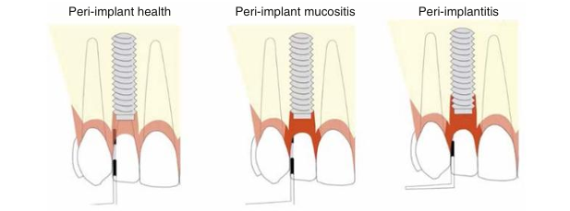
Peri Implant Diseases and Conditions

Slide 90
Peri implant health is clinically characterized by the absence of visual signs of inflammation and lack of BOP.
peri implant mucositis exhibits visual signs of inflammation and/or BOP but without loss of supportive or marginal bone.
Peri implantitis is a pathological condition with inflammation and/or BOP accompanied by progressive loss of supportive bone .

